Slide 1

Digital History: Merchant Mariners in World War Two Dataset
Alexander Billinis
Digital Methods Final Project
May 1, 2024

Slide 2
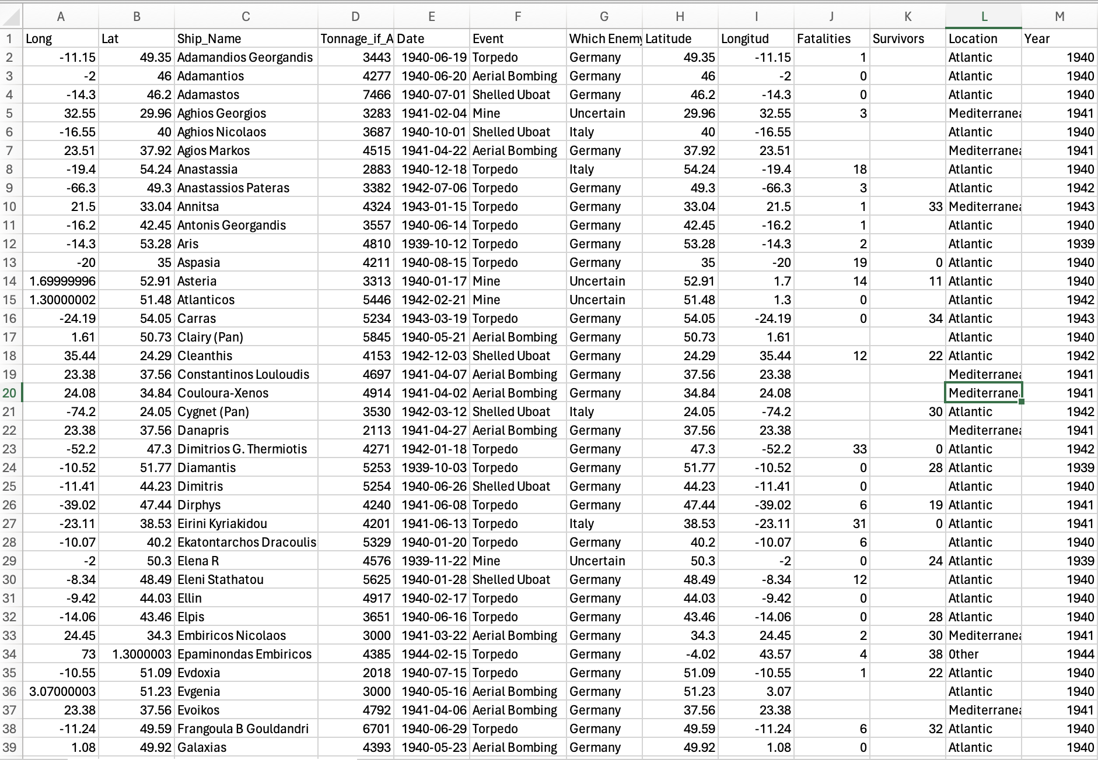
The Dataset: Greek Merchant Ships Sunk in World War Two
Though Neutral until 1940/1941, Greek Ships were attacked.
American Ships were rarely attacked while America was neutral.
Why the Difference? What do the Historiography and Narratives say?
What was the role of Aerial Bombing?
Some quick figures.
Conclusions . . . .

Slide 3
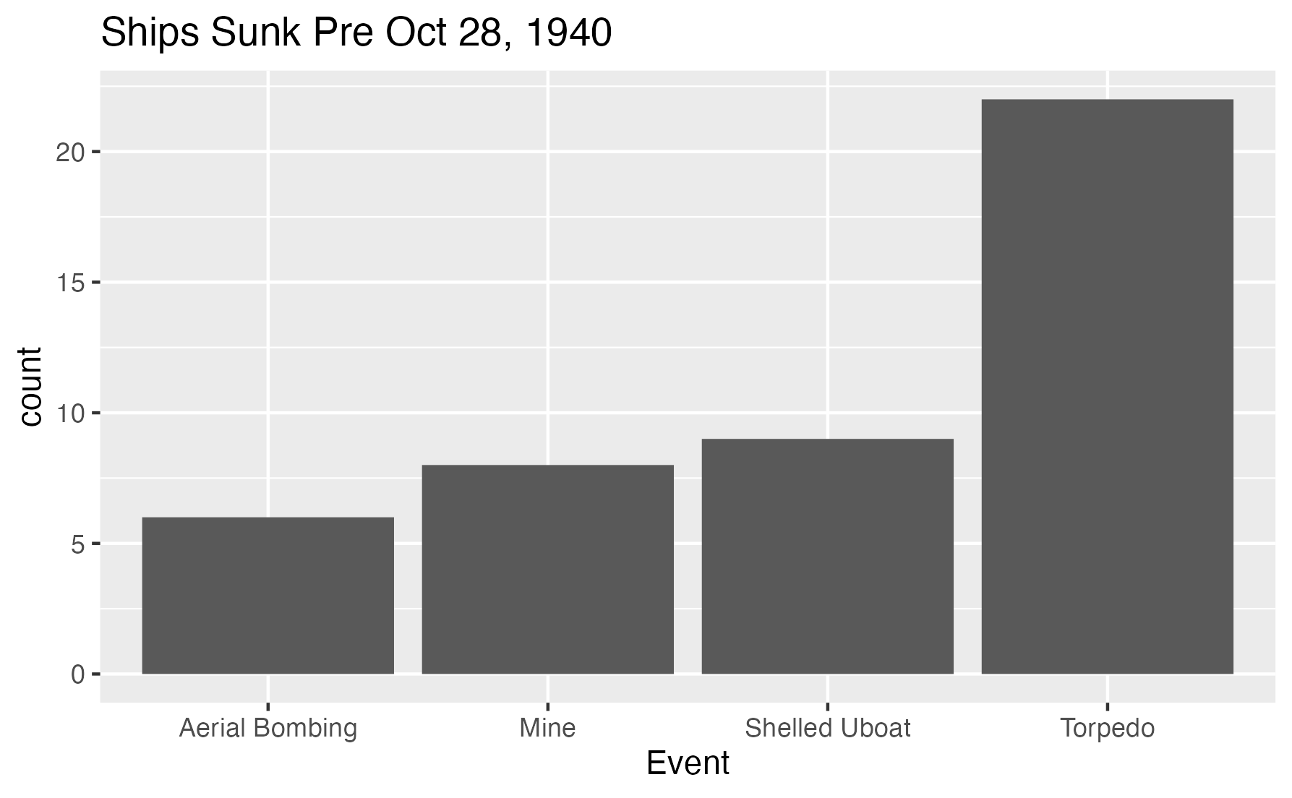
Greek Ships Sunk, prior to Italian Invasion: 45

Slide 4
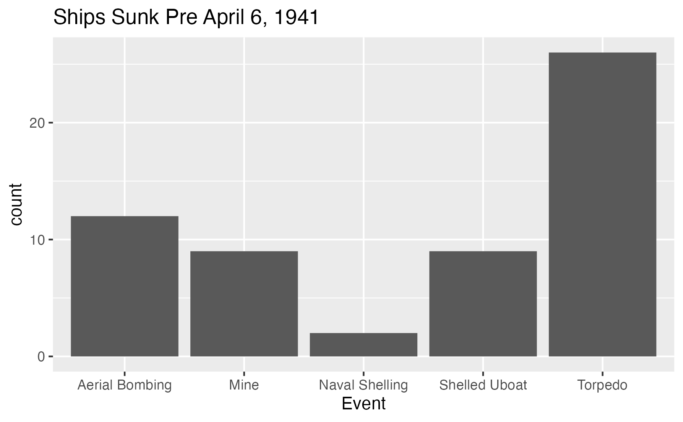
Greek Ships Sunk, prior to German Invasion: 58

Slide 5
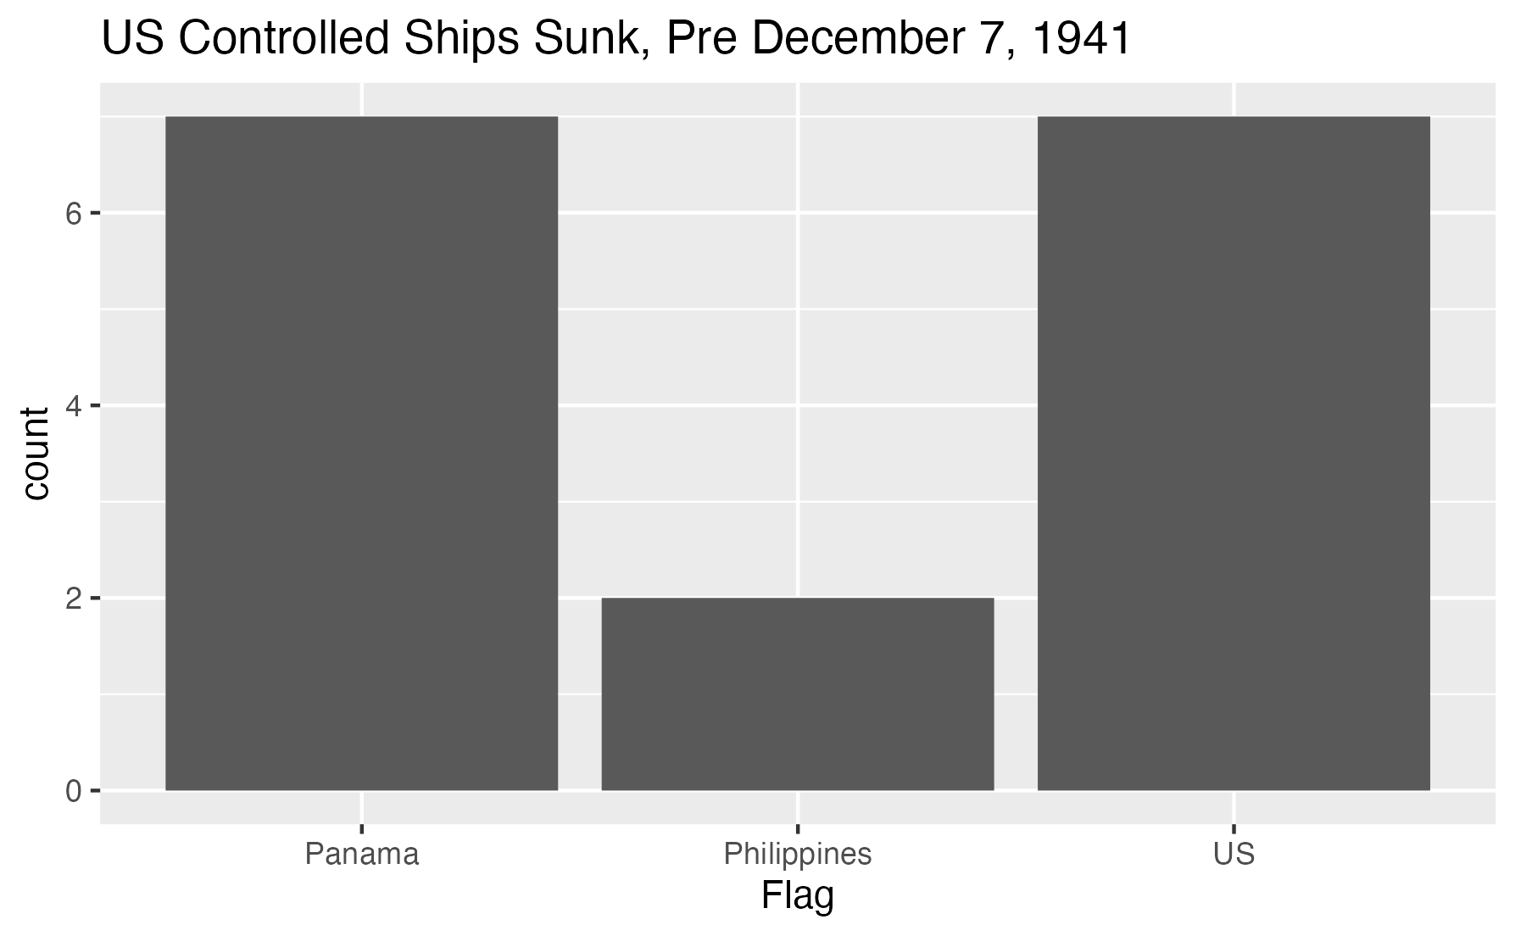
US Ships Sunk prior to Japanese Attack: 7 + 9 (Non-US Flag)

Slide 6
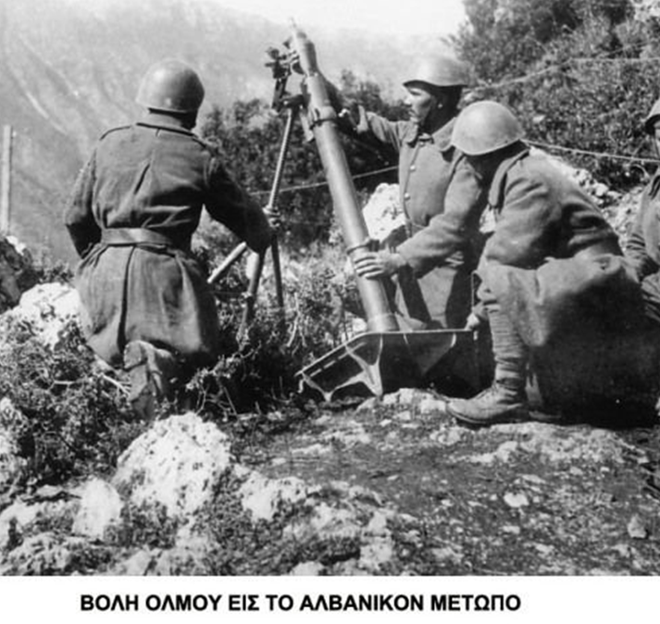
Why The Difference?
Greece was small and poor but with a massive fleet.
The British needed the Greek fleet, and basically forced Greek ships to be part of the British supply effort.
The US Neutrality Act of 1939 restricted war commerce to “Cash and Carry.”
And the US had the second largest navy in the world and was the world’s premier industrial power.
Nearly half of the Greek losses occurred before Greece and Germany were at war.
“The Weak suffer what they must.” –Thucydides

Slide 7
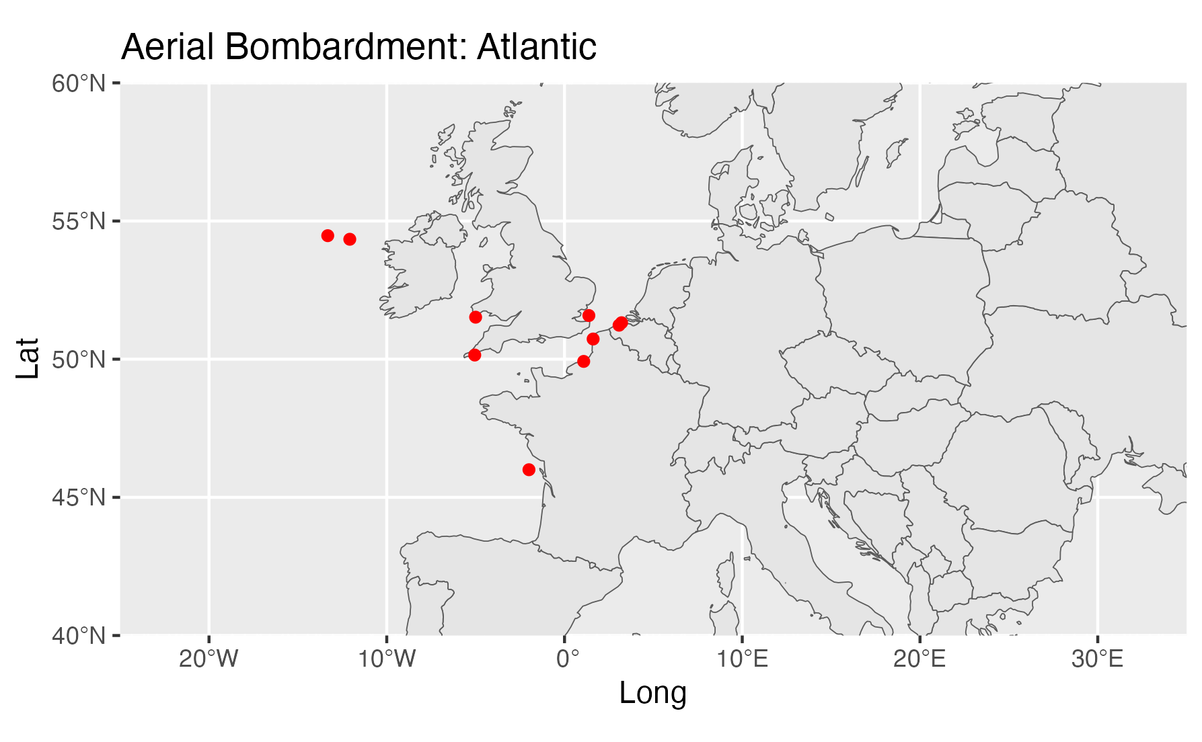
Luftwaffe: Atlantic

Slide 8
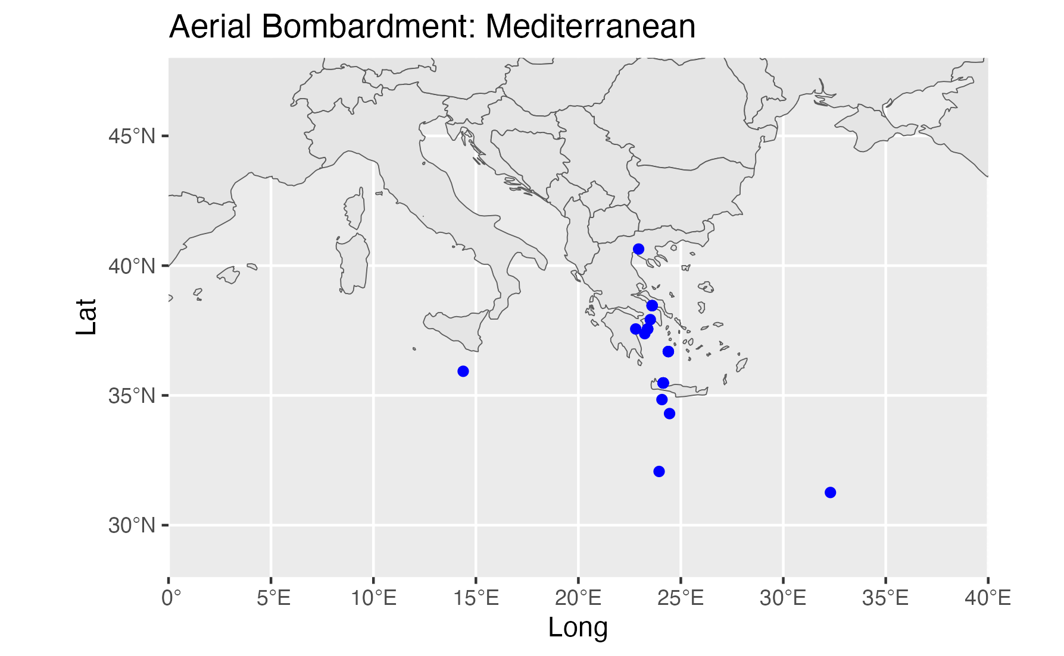
Luftwaffe: Mediterranean

Slide 9
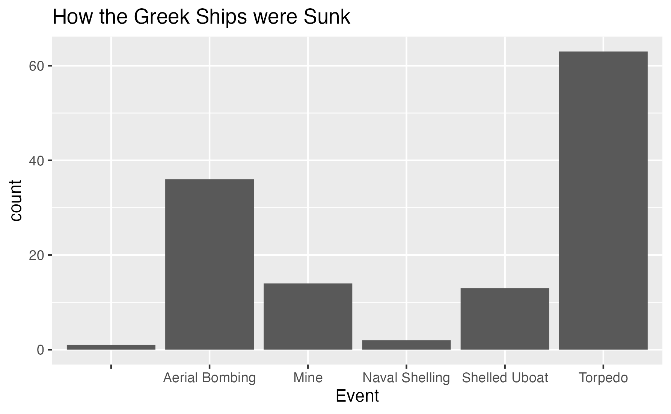
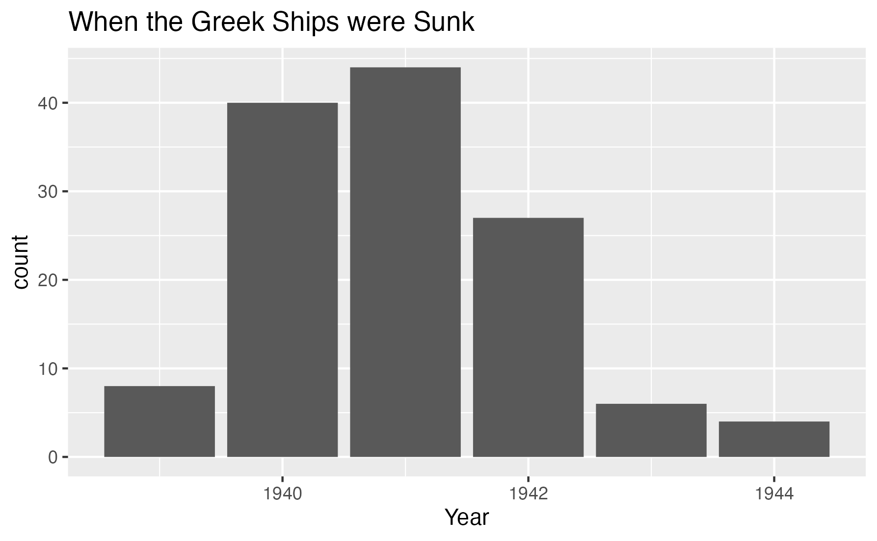
More Derived Data: The How and When

Slide 10

Conclusions
Some Neutrals are more equal than others.
But Greek ships actively carried war materials and supplies for the Allies in spite of the country’s early neutrality before the country was attacked.
Air Attacks played a key role in the destruction of the Greek merchant fleet.
Dataset-derived information can play a key role in understanding events.
Beyond the data, there are faces and names, and wives, sons, daughters . . . And Grandsons.
Alexandros Constantinou Billinis, martyred at sea February 6, 1942.

